Slide 1
SMART BAND FOR SENIOR CITIZENS
A BAND FOR ALL NEEDS

Slide 2
PROBLEM STATEMENT :
Most of the senior citizens/bed ridden people need 24/7 assistance for fulfilling their basic needs which is practically impossible in today’s world .
Most of the senior citizens get critically injured due to fall and need timely medical assistance.
Also they have to be always reminded for taking medicines.
SOLUTION :
A Smart Gesture based band that :
Conveys message to the care-taker immediately based upon the gesture made.
Can detect the fall of a person and alert the care taker.
Can be used to make a remainder system for medical schedule.

Slide 3
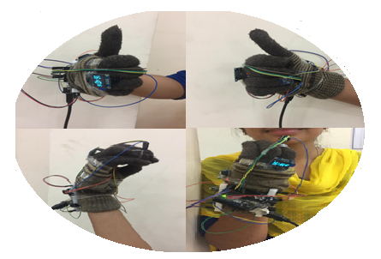
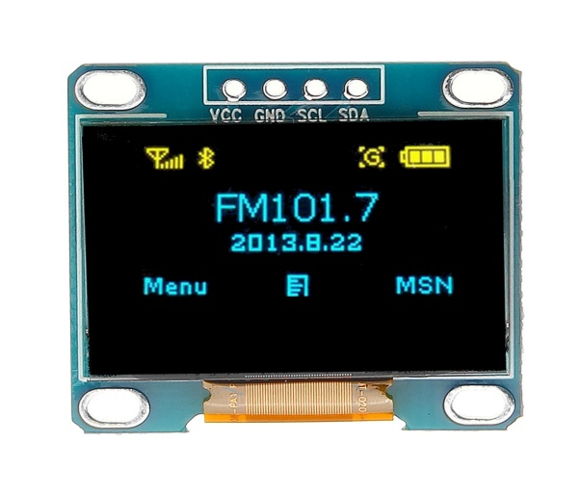
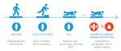
PRODUCT / SERVICE :
I NEED FOOD
1. Gesture Based Messaging System :
When a senior citizen/ bedridden person makes a particular gesture, message is sent to all the registered numbers.
2. Fall Detection :
If a person falls suddenly, an alert message is sent to the care taker.
3. Voice Assistant:
Through speech command , care taker is notified.

Slide 4
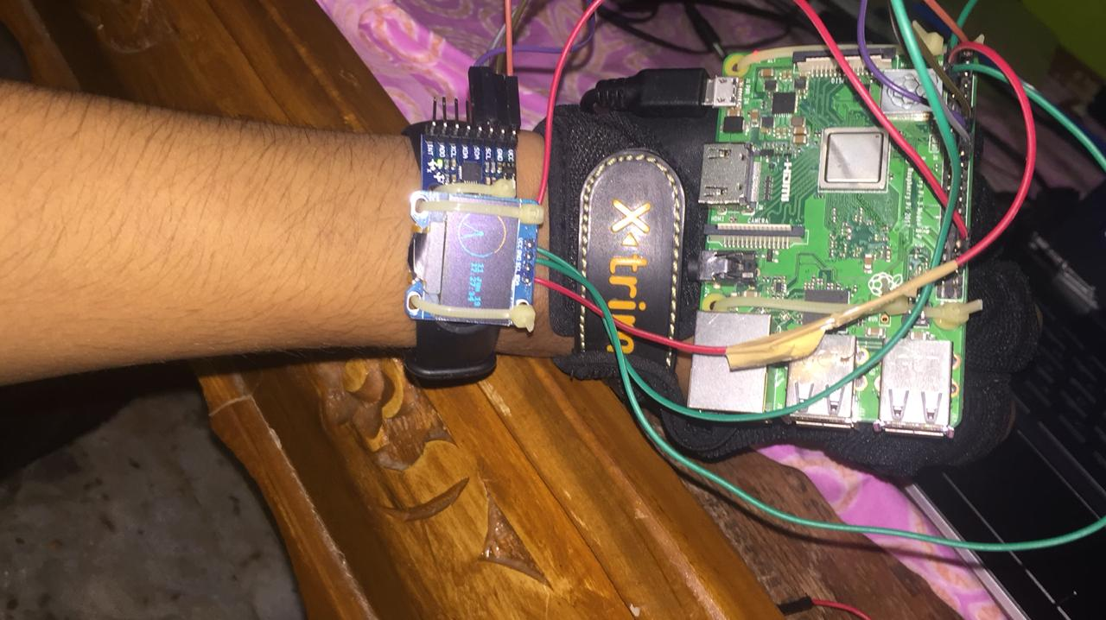
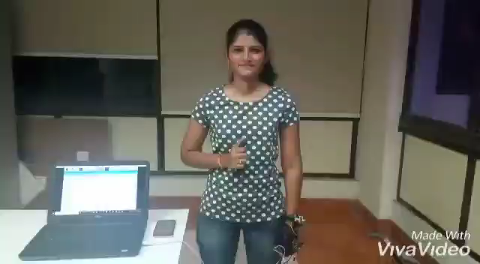
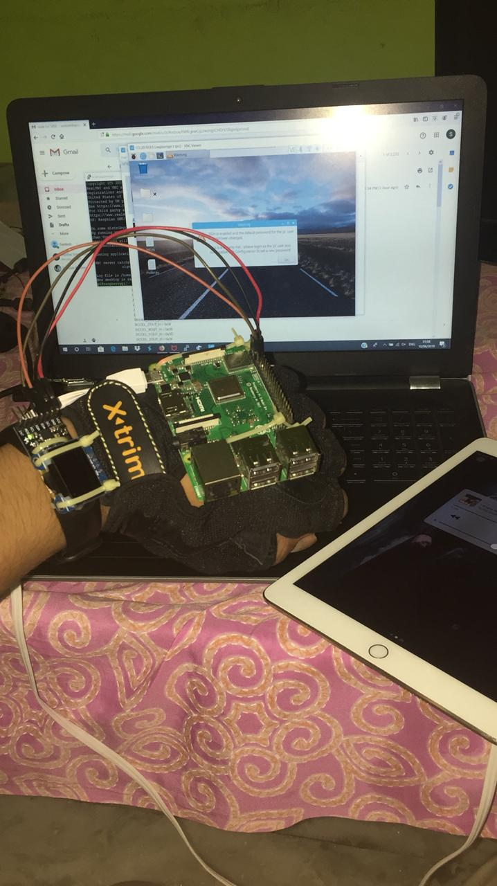
WORKING PROTOTYPE :

Slide 5
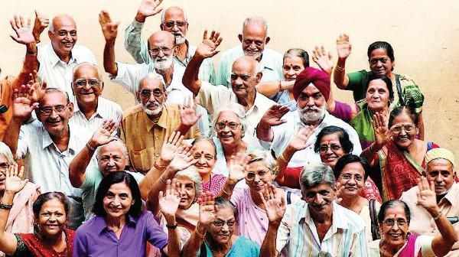
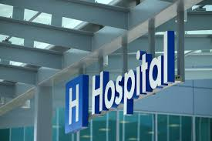
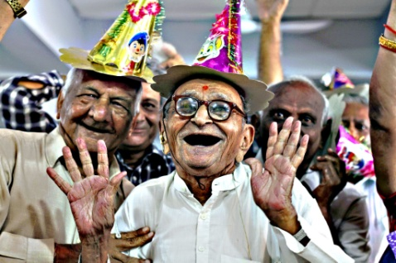
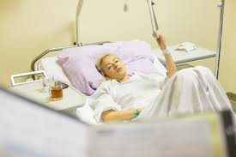
MARKET :
Prospective customers for our product are all the elderly people.
POTENTIAL CUSTOMERS
PROSPECTIVE CUSTOMERS
Potential customers for our product are hospitals, old age homes, people suffering from chronic diseases and bed ridden patients.

Slide 6
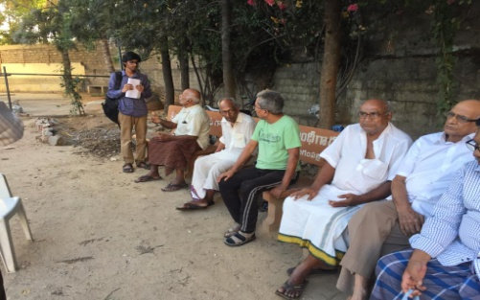
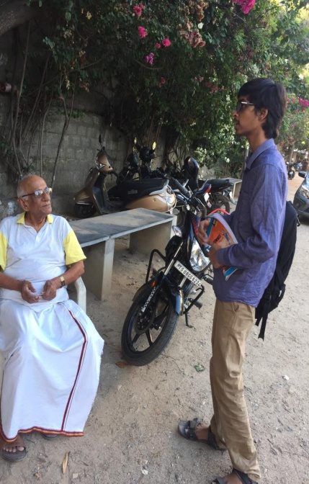
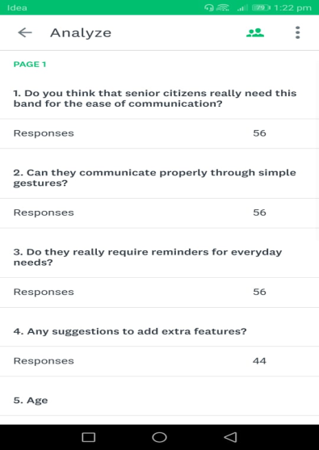
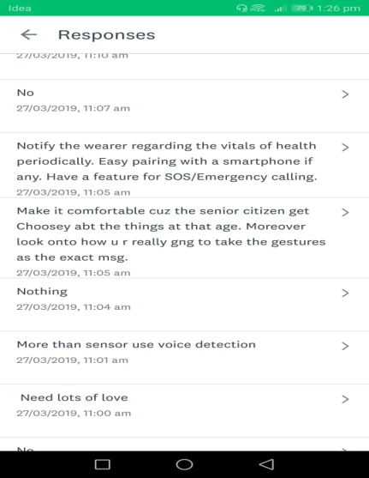
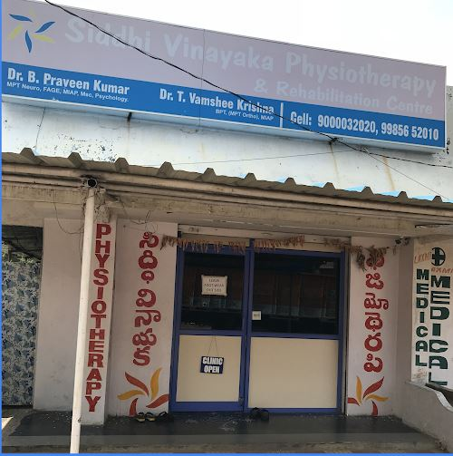
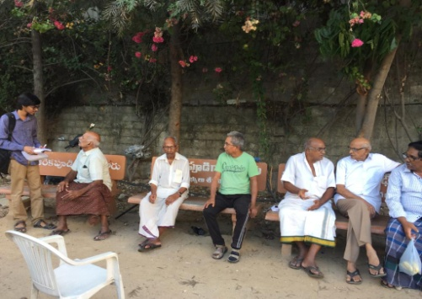
MARKET RESEARCH :
Created an online survey and considered those responses for the development of our project.
Visited an old age home in Nizampet to enquire how our project would be useful to the senior citizens.
We also visited a physiotherapist in west marredpally.
OLD AGE HOME
PHYSIOTHERAPIST
ONLINE SURVEY

Slide 7
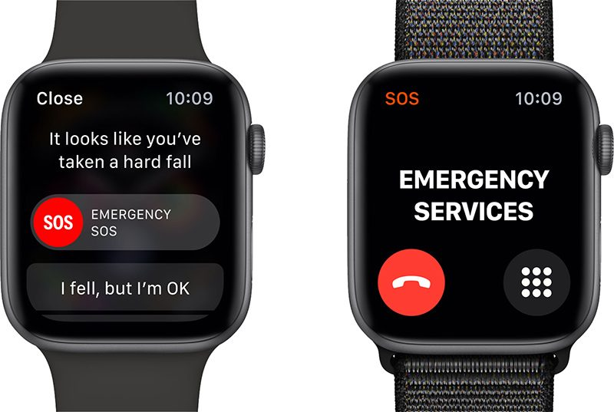
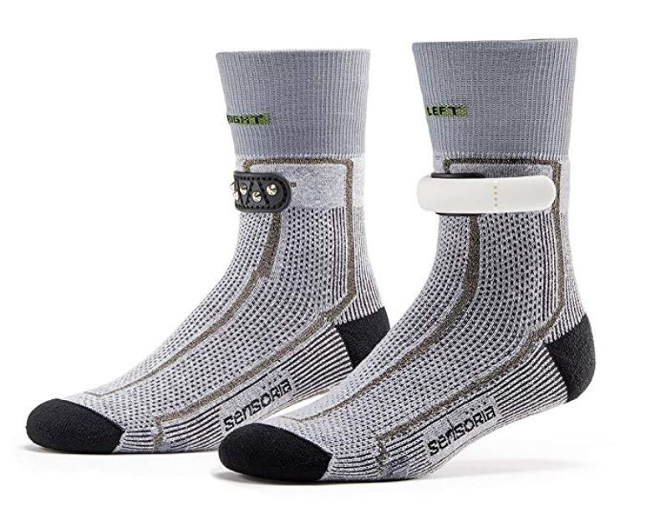
COMPETITION :
One of our competitor is Apple Band.
Apple bands give us information only about Fall detection.
Our other competitor is the Sensoria socks.
This device gives helpful data to the old people about their health status.
Our product is unique as it is a gesture based glove and fall detection in our band is done by training ML model using various datasets making it more efficient.

Slide 8
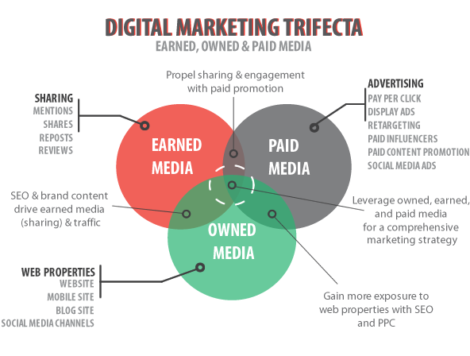
MARKETING STRATEGY :
Our customers are
Hospitals
Old age homes
Care takers of old people
We reach them through advertising, spreading information to people through doctors.
Online advertising, Social Media, Recommendation by Doctors/Medical shops etc., are the methods we will use for promoting our product.
We can promote our product by approaching NGO’s , old age homes personally.

Slide 9

Revenue Model :
The revenue can be generated by selling the Band to the customer.
Overall cost for a single piece :
MPU6050 – Rs. 150/-
GSM – Rs. 700/-
Microprocessor – Rs. 1000/-
Oled – Rs. 700/-
Designing of the Product – Rs. 300/-
Power Bank-Rs.500/-
Microphone-Rs.200/-
Total Cost : Rs. 3550/-

Slide 10
Financial Implication for the village
What to write??

Slide 11
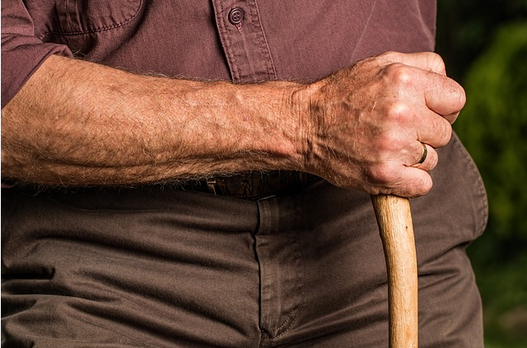
Future Upgrades for our Product :
Fall Prediction :
According to a research, it was found that a gait speed decline of 5 cm/s was associated with a 86% probability of falling within the next 3 weeks.
We will be including vitals like pulse, blood pressure etc.
Reference of research : https://www.expresscomputer.in/news/how-iot-can-help-in-preventing-falls-for-senior-citizens/18926

